Slide 1

Introduction to Python for Cybersecurity 1 Hour
Instructors: Loni Taylor, Puspita Chatterjee

Slide 2

Overview of the Presentation
What is Python
Installation Guidelines
Benefits of Python Programming
Why Python for Cybersecurity?
Top Python Libraries for Cybersecurity
Uses for Cybersecurity
Coding Demonstration
https://denizhalil.com/wp-content/uploads/2024/02/Cybersecurity-with-Python-A-Comprehensive-Roadmap-by-denizhalil.jpeg

Slide 3
What is Python
Python is a high-level, general-purpose programming language used in web development, data science, machine learning, automation, and more. Python is known for its readability, ease of learning, and the vast number of libraries and frameworks available for various tasks.

Slide 4

Installation Guidelines
To install Python, first download the appropriate installer from the official Python website. Then, run the installer and follow the on-screen instructions. During installation, consider adding Python to your system's PATH to easily access it from the command line. Finally, verify the installation by opening a command prompt and typing python -V

Slide 5
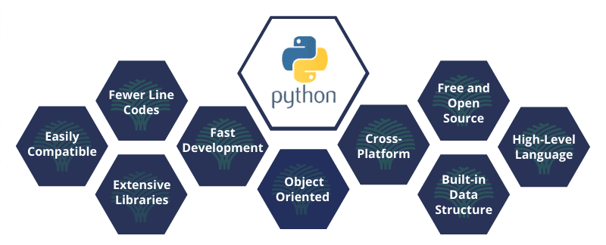
Benefits of Python Programming
https://www.datasciencecentral.com/wp-content/uploads/2021/10/python-development-services-benefits-1.png
Notes:
Python programming offers numerous benefits, including its simplicity, readability, versatility, extensive libraries, strong community support, and cross-platform compatibility, making it a popular choice for various applications.

Slide 6
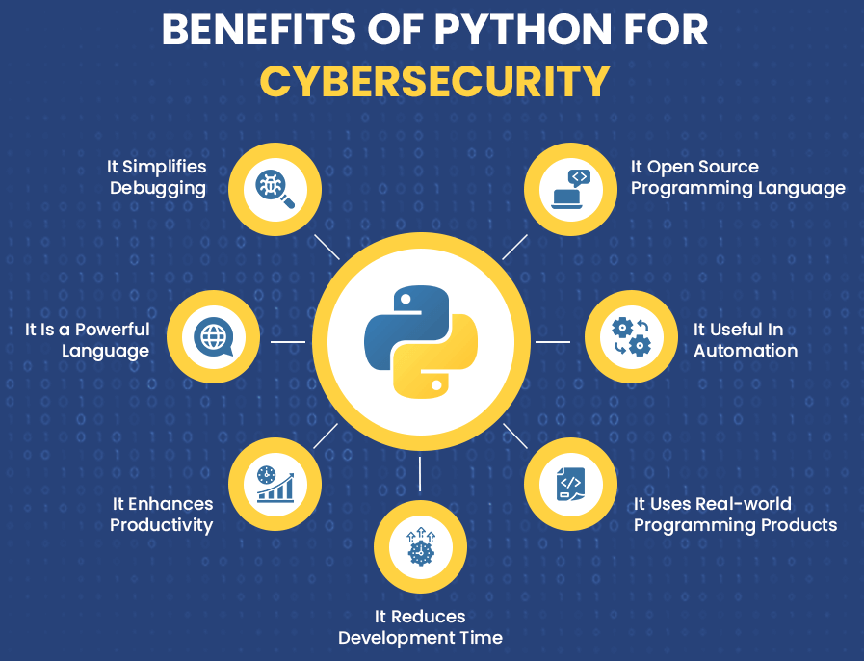
Why Python for Cybersecurity
Simplicity
Extensive libraries
Ability to automate tasks
https://cdn.auxanoglobalservices.com/wp-content/uploads/2022/09/Benefits-of-Python-for-Cybersecurity.png
Notes:
Python is favored in cybersecurity for its simplicity, extensive libraries, and ability to automate tasks, making it a versatile tool for both offensive and defensive security operations, including penetration testing, malware analysis, and incident response.

Slide 7
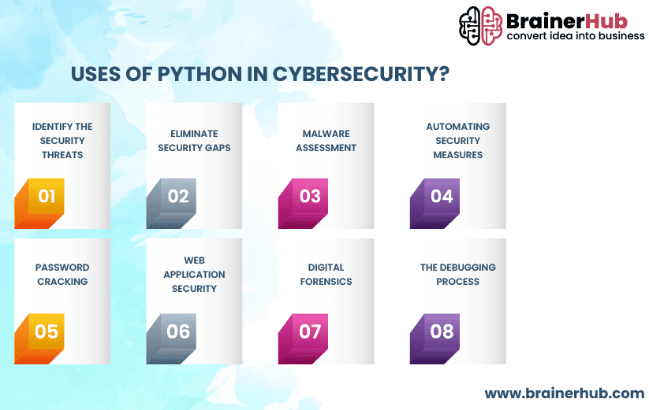
Uses for Cybersecurity
Goal: Stop threats before they cause harm and quickly respond when they do.
Network scanning
Vulnerability analysis
Building security tools
https://www.brainerhub.com/wp-content/uploads/2024/05/Uses-of-Python-in-Cybersecurity.png
Notes:
Python is extensively used in cybersecurity for its versatility and ease of use. It's a popular choice for tasks like network scanning, vulnerability analysis, and building security tools. Python's rich ecosystem of libraries, such as Scapy and Pwntools, further enhances its utility in areas like packet manipulation, exploit development, and automation.
Offensive Security:
Penetration Testing:
Python is used to create scripts for identifying vulnerabilities, simulating attacks, and testing security systems.
Exploit Development:
Libraries like Pwntools help in crafting customized exploits for various vulnerabilities, according to Panther Labs.
Malware Analysis:
Python can be used to analyze and reverse-engineer malware samples, understand their behavior, and identify potential vulnerabilities.
Password Cracking:
Tools like Hashcat and John the Ripper utilize Python for cracking passwords and testing their strength.
Network Scanning:
Scapy is used to manipulate network packets and perform network scans, helping identify active hosts and services.
SQL Injection:
Python is used in tools like Sqlmap to detect and exploit SQL injection vulnerabilities in web applications.

Slide 8

















Top Python Libraries for Cybersecurity
Scapy | Requests | Beautiful Soup | YARA
Nmap | Cryptography | Matplotlib | Paramiko
PyBrain | Pycrypto | Impacket | Pandas
Scikit-learn | NumPy | Pwntools | OWASP ZAP
Pexpect | TensorFlow | Faker | Mechanize
Pymetasploit3 | Twisted | IPython | Rawsocketpy

Slide 9
Key Cybersecurity Concepts
Ethical Hacking
Encryption
Also known as penetration testing or white-hat hacking.
Involves testing systems to find and fix vulnerabilities before attackers exploit them.
Helps strengthen defenses through controlled, authorized attacks.
The process of converting data into a coded format to prevent unauthorized access.
Used in everything from messaging apps to online banking.
Two main types: Symmetric (same key) and Asymmetric (public/private key).

Slide 10
Key Cybersecurity Concepts
Network Security
Threat Detection
The practice of protecting the integrity, confidentiality, and availability of data as it travels across or is stored in networks.
Includes both hardware (like firewalls) and software (like antivirus, VPNs, IDS/IPS).
The process of identifying malicious activity that could compromise the system.
Often involves monitoring traffic, analyzing logs, and spotting unusual behavior.

Slide 11
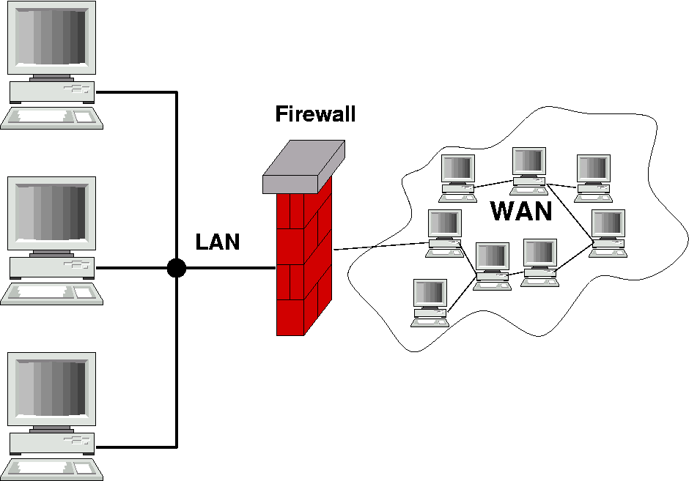
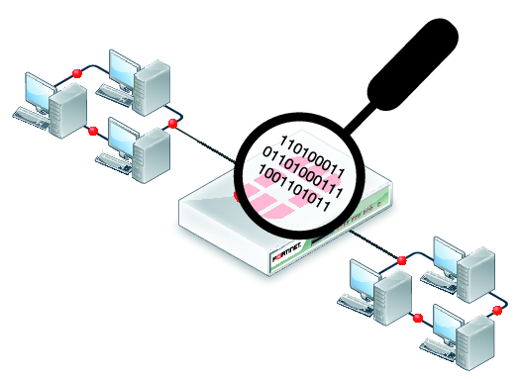
Examples of Tools
Firewalls: Filter incoming and outgoing traffic.
Intrusion Detection Systems (IDS): Alert when suspicious activity is detected.
SIEM (Security Information and Event Management): Combines real-time monitoring and historical analysis.
Packet Sniffers: Tools like Wireshark to analyze network packets.

Slide 12
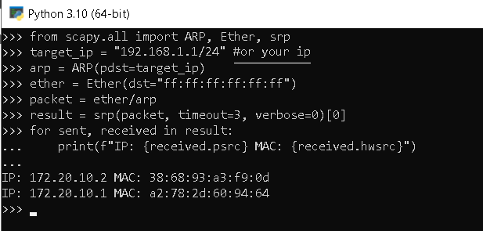
Coding Demonstration: Network Scanning and Packet Analysis with Scapy
Make sure the following libraries are installed via pip:
Scapy
Winpcap/npcap
Basic Network Scan results:
send ARP requests to discover devices on the network
Notes:
Network Scanning and Packet Analysis with Scapy
One of the key aspects of cybersecurity is understanding network traffic and identifying potential vulnerabilities. Python’s Scapy library allows you to create, manipulate, and send packets on a network, making it an invaluable tool for network scanning and packet analysis. Whether you’re conducting security assessments or monitoring your network’s health, Scapy empowers you to interact with packets at a granular level.
To perform a basic network scan, you can use the following Scapy code snippet:
from scapy.all import ARP, Ether, srp
target_ip = "172.20.10.2/24"#"192.168.1.1/24" #or your ip
arp = ARP(pdst=target_ip)
ether = Ether(dst="ff:ff:ff:ff:ff:ff")
packet = ether/arp
result = srp(packet, timeout=3, verbose=0)[0]
for sent, received in result:
print(f"IP: {received.psrc} MAC: {received.hwsrc}")
In this example, we use Scapy to send ARP requests to discover devices on the network. The responses provide valuable information about IP-MAC address mappings, which is crucial for network security and management.

Slide 13
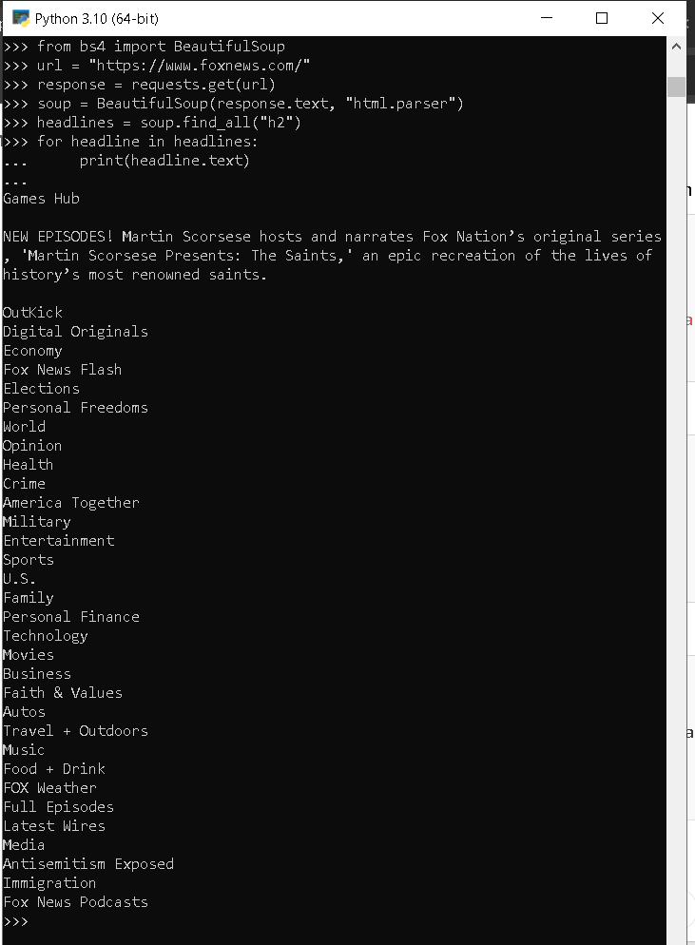
Coding Demonstration: Web Scraping
Fetch the HTML content of a news website
Parse it using Beautiful Soup
Extract headlines
Notes:
Web scraping has become a fundamental skill for extracting valuable information from websites and online sources. Python offers powerful libraries that enable efficient web scraping and automation. In this section, we’ll explore how to harness these capabilities to gather data and streamline tasks.
Introduction to Web Scraping
Web scraping involves extracting data from websites in a structured and automated manner. Python’s Beautiful Soup and Requests libraries provide a robust foundation for web scraping projects.
To get started, consider this basic example that scrapes headlines from a news website:
import requests
from bs4 import BeautifulSoup
url = "https://www.foxnews.com/"
response = requests.get(url)
soup = BeautifulSoup(response.text, "html.parser")
headlines = soup.find_all("h2")
for headline in headlines:
print(headline.text)
In this snippet, Python fetches the HTML content of a news website, parses it using Beautiful Soup, and extracts headlines. With web scraping, you can gather data for analysis, research, or content creation.

Slide 14


Put it together: Automated Incident Response with Python
Steps:
Use web scraping to monitor security forums and websites for new threat indicators.
Automate the collection of relevant threat data, such as IP addresses and domain names.
Integrate the collected data with your existing security infrastructure to enhance threat detection and response.
Notes:
Automated Incident Response with Python
Python’s automation capabilities can significantly enhance incident response in cybersecurity. By combining web scraping and automation, you can create scripts that monitor security-related websites and forums for the latest vulnerabilities and threat indicators.
Here’s an outline of an automated incident response script using Python:
Use web scraping to monitor security forums and websites for new threat indicators.
Automate the collection of relevant threat data, such as IP addresses and domain names.
Integrate the collected data with your existing security infrastructure to enhance threat detection and response.
By harnessing Python’s capabilities, you can create a dynamic and responsive incident response system that adapts to emerging threats.

Slide 15

Assignments
DIY-Try it at home:
Navigate to this github repository and debug/try this code automating an incident response. Try to see where each step performs the task and note what types of improvements can be made or implemented in your own systems.

Slide 16



Pre-Workshop Reading
Npcap download: Packet capture library for Windows
WinPcap: For legacy systems
JupyterLab: Installing Jupyter

Slide 17
Further Reading
EC-Council University: The Power of Python in Cybersecurity Education
Yash Lote: Developing a Basic Network Packet Sniffer, Medium, Feb 6, 2024
Geeksforgeeks: Packet sniffing using Scapy, 05 Jul, 2021
Tutorialspoint: Network Packet Sniffing

Slide 18
Thank You!!

